Slide 1
Introduction to Xamarin
김영욱 Technical Evangelist
부장/ DX / Microsoft
youngwook@outlook.com
영욱닷컴 http://Youngwook.com
Notes:
Welcome to Go Mobile with C#, Visual Studio, and Xamarin

Slide 2






Slide 3


Slide 4


War of IT

Slide 5
Visual Studio Community. Android, Windows emulator. Xamarin. Windows 10 SDK. Azure Account. ASP.NET 4.2
오늘의 재료

Slide 6
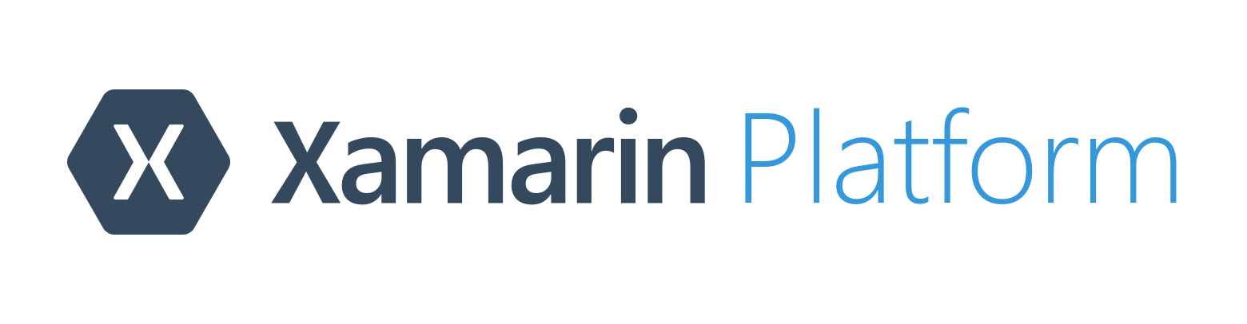
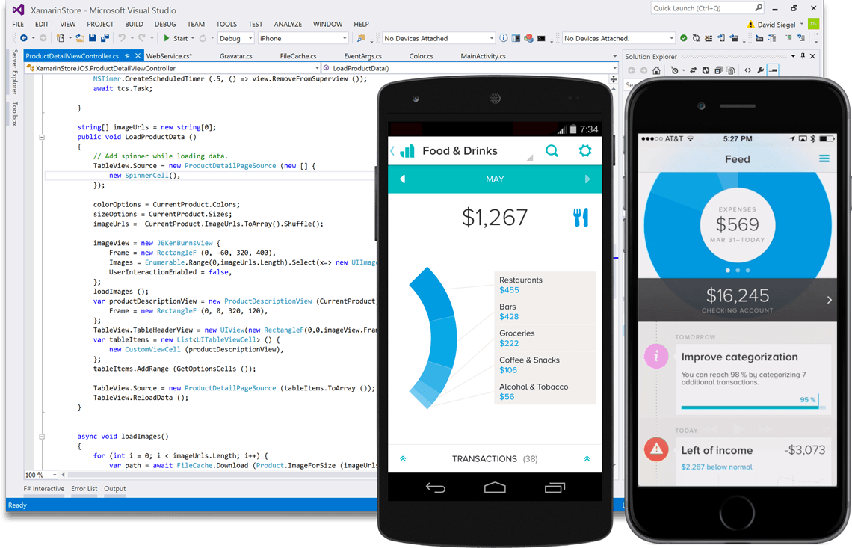
Create native iOS, Android, Mac and
Windows apps in Visual Studio and C#
Notes:
What is Xamarin at its core?
Xamarin allows you to create native iOS, Android, Mac and Windows apps in Visual Studio and C#

Slide 7
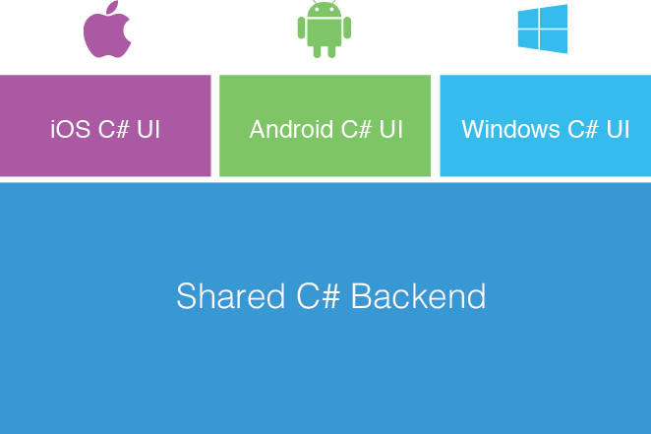
Xamarin’s Unique Approach
Shared C# codebase
100% native API access
High performance
Notes:
Build a UI natively on a per-platform basis with C#
Use native controls and native paradigms
iOS
XIB or Code
Android
XML layouts
Windows
XAML
Share everything that isn’t platform-specific
100% access to all the native bits
High performance
End Result
One shared app logic code base for iOS, Android, Mac, Windows Phone, and Windows

Slide 8
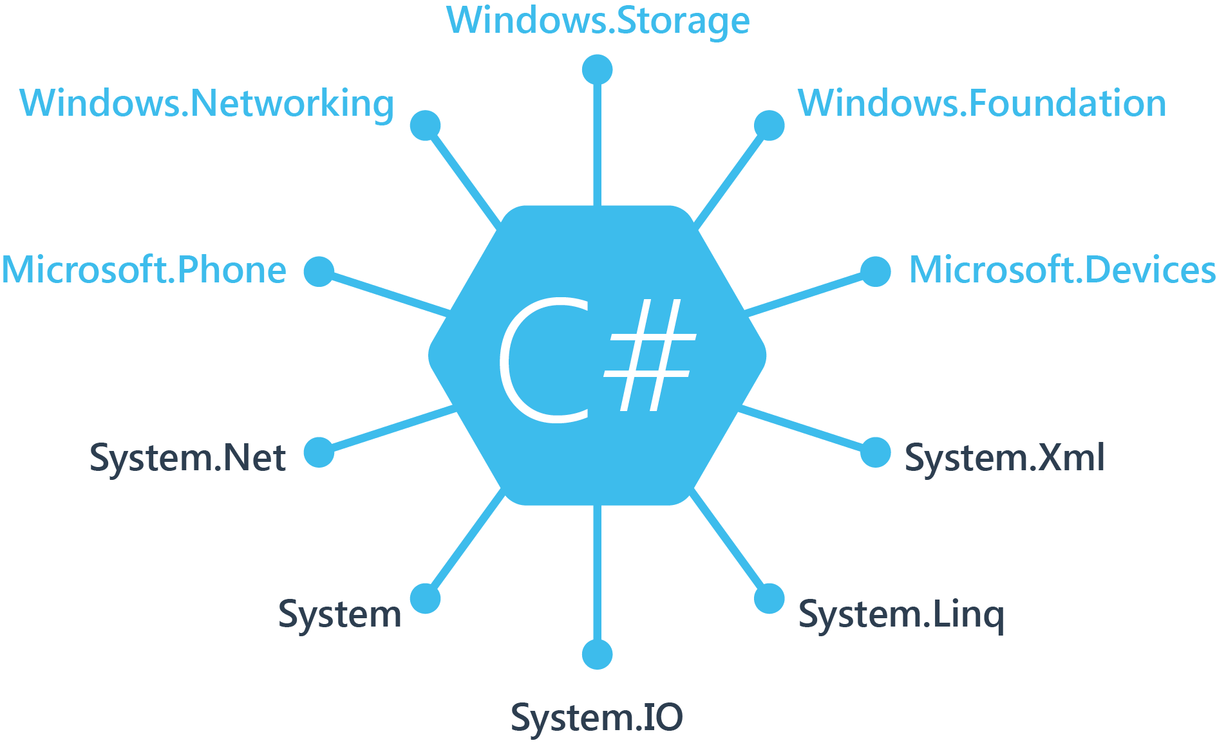
Windows APIs
Notes:
Mentioned 100% API access earlier
If you’ve ever developed for a Windows Platform these .NET namespaces look familiar
When you move to Windows Phone + Store, you still have access to .NET namespaces + a few new ones

Slide 9
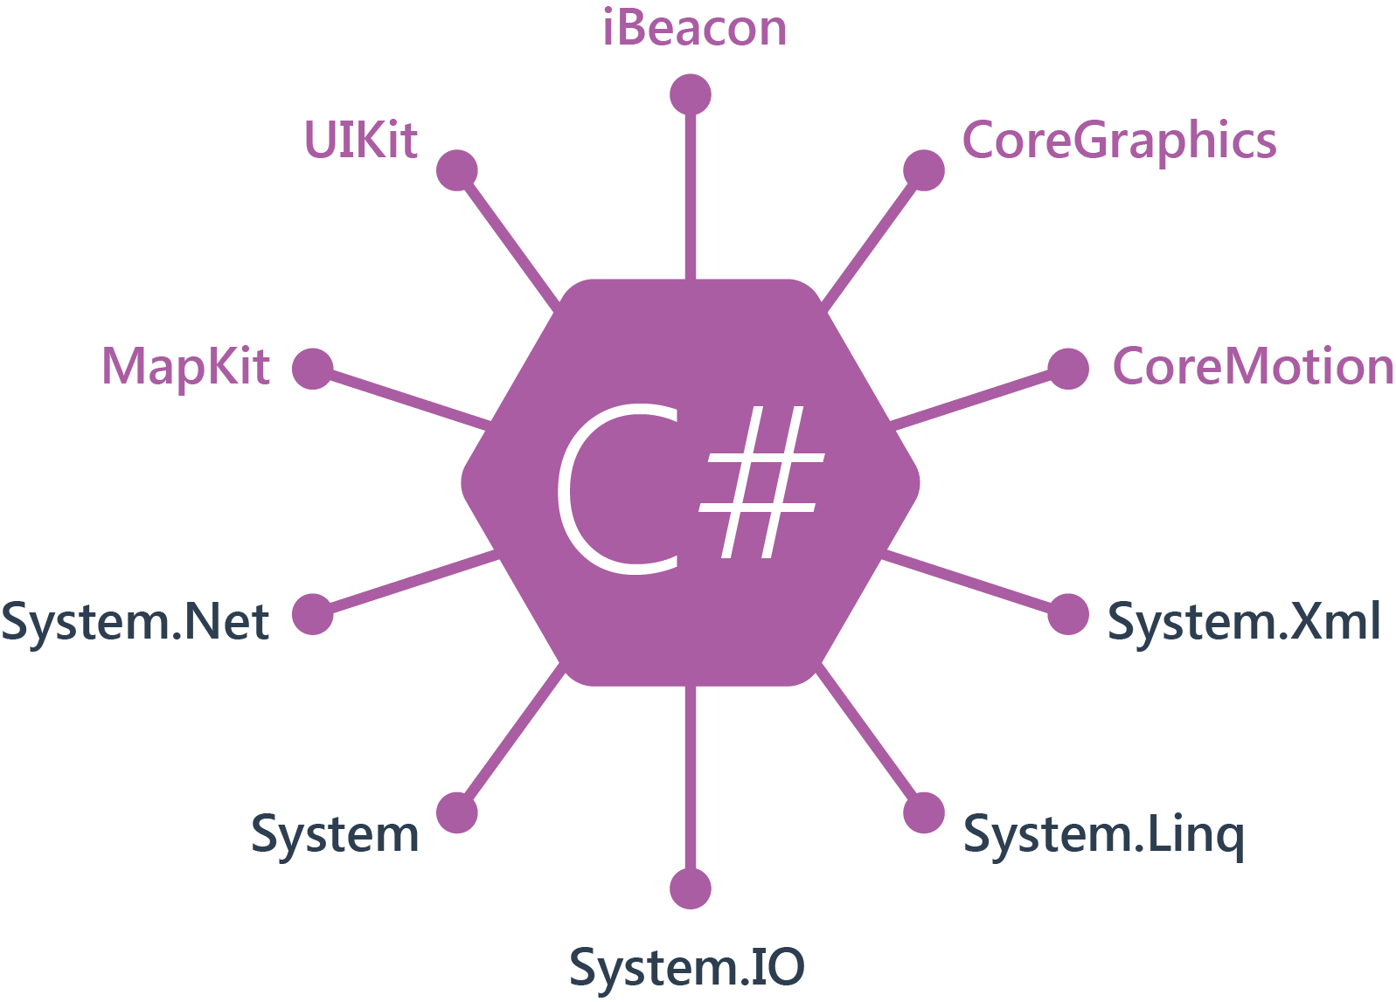
.NET + iOS APIs | 100% Coverage
Notes:
You can still see all .NET namespaces and libraries
Xamarin gives us 100% API coverage to each iOS API in its SDK
UIKit mentioned earlier to build native user interfaces
iBeacon anyone?

Slide 10
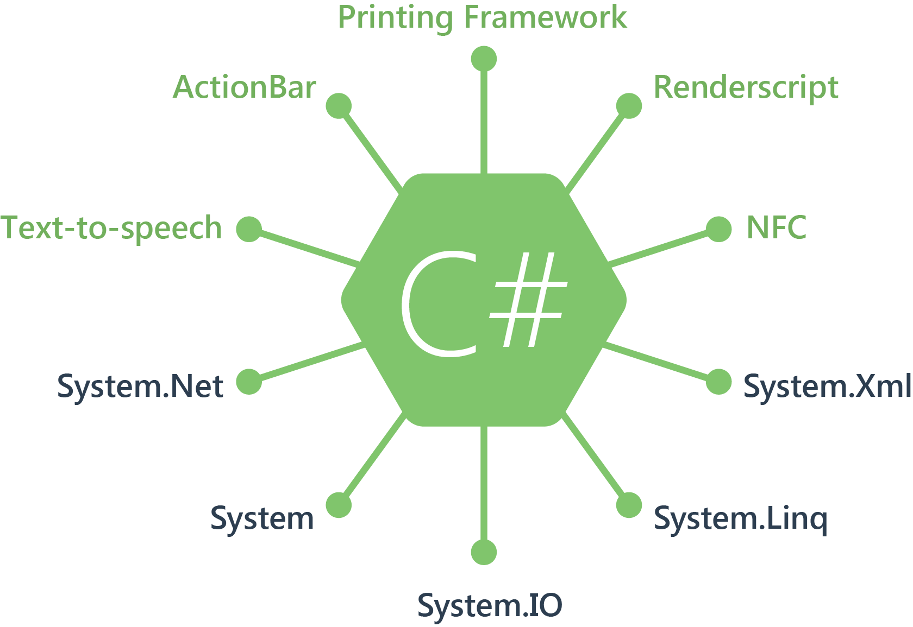
.NET Android APIs | 100% Coverage
Notes:
Same is true for Android

Slide 11
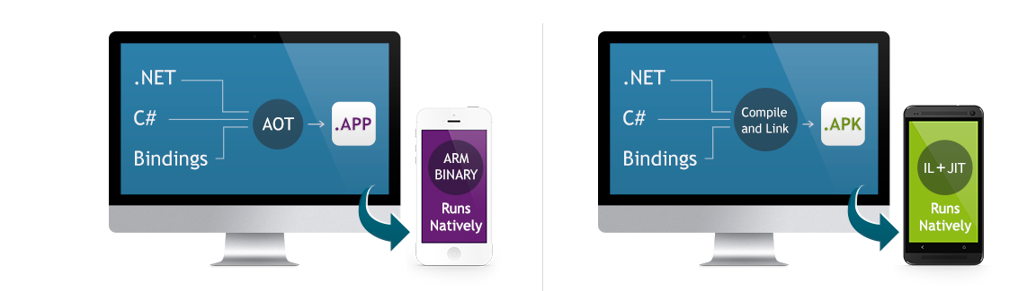
Native Performance
Xamarin.iOS does full Ahead Of Time (AOT) compilation to produce an ARM binary for Apple’s App Store.
Xamarin.Android takes advantage of Just In Time (JIT) compilation on the Android device.
Notes:
There is no compromise on performance.
Xamarin apps look and feel native because they are native.
Say exactly, pause for effect

Slide 12
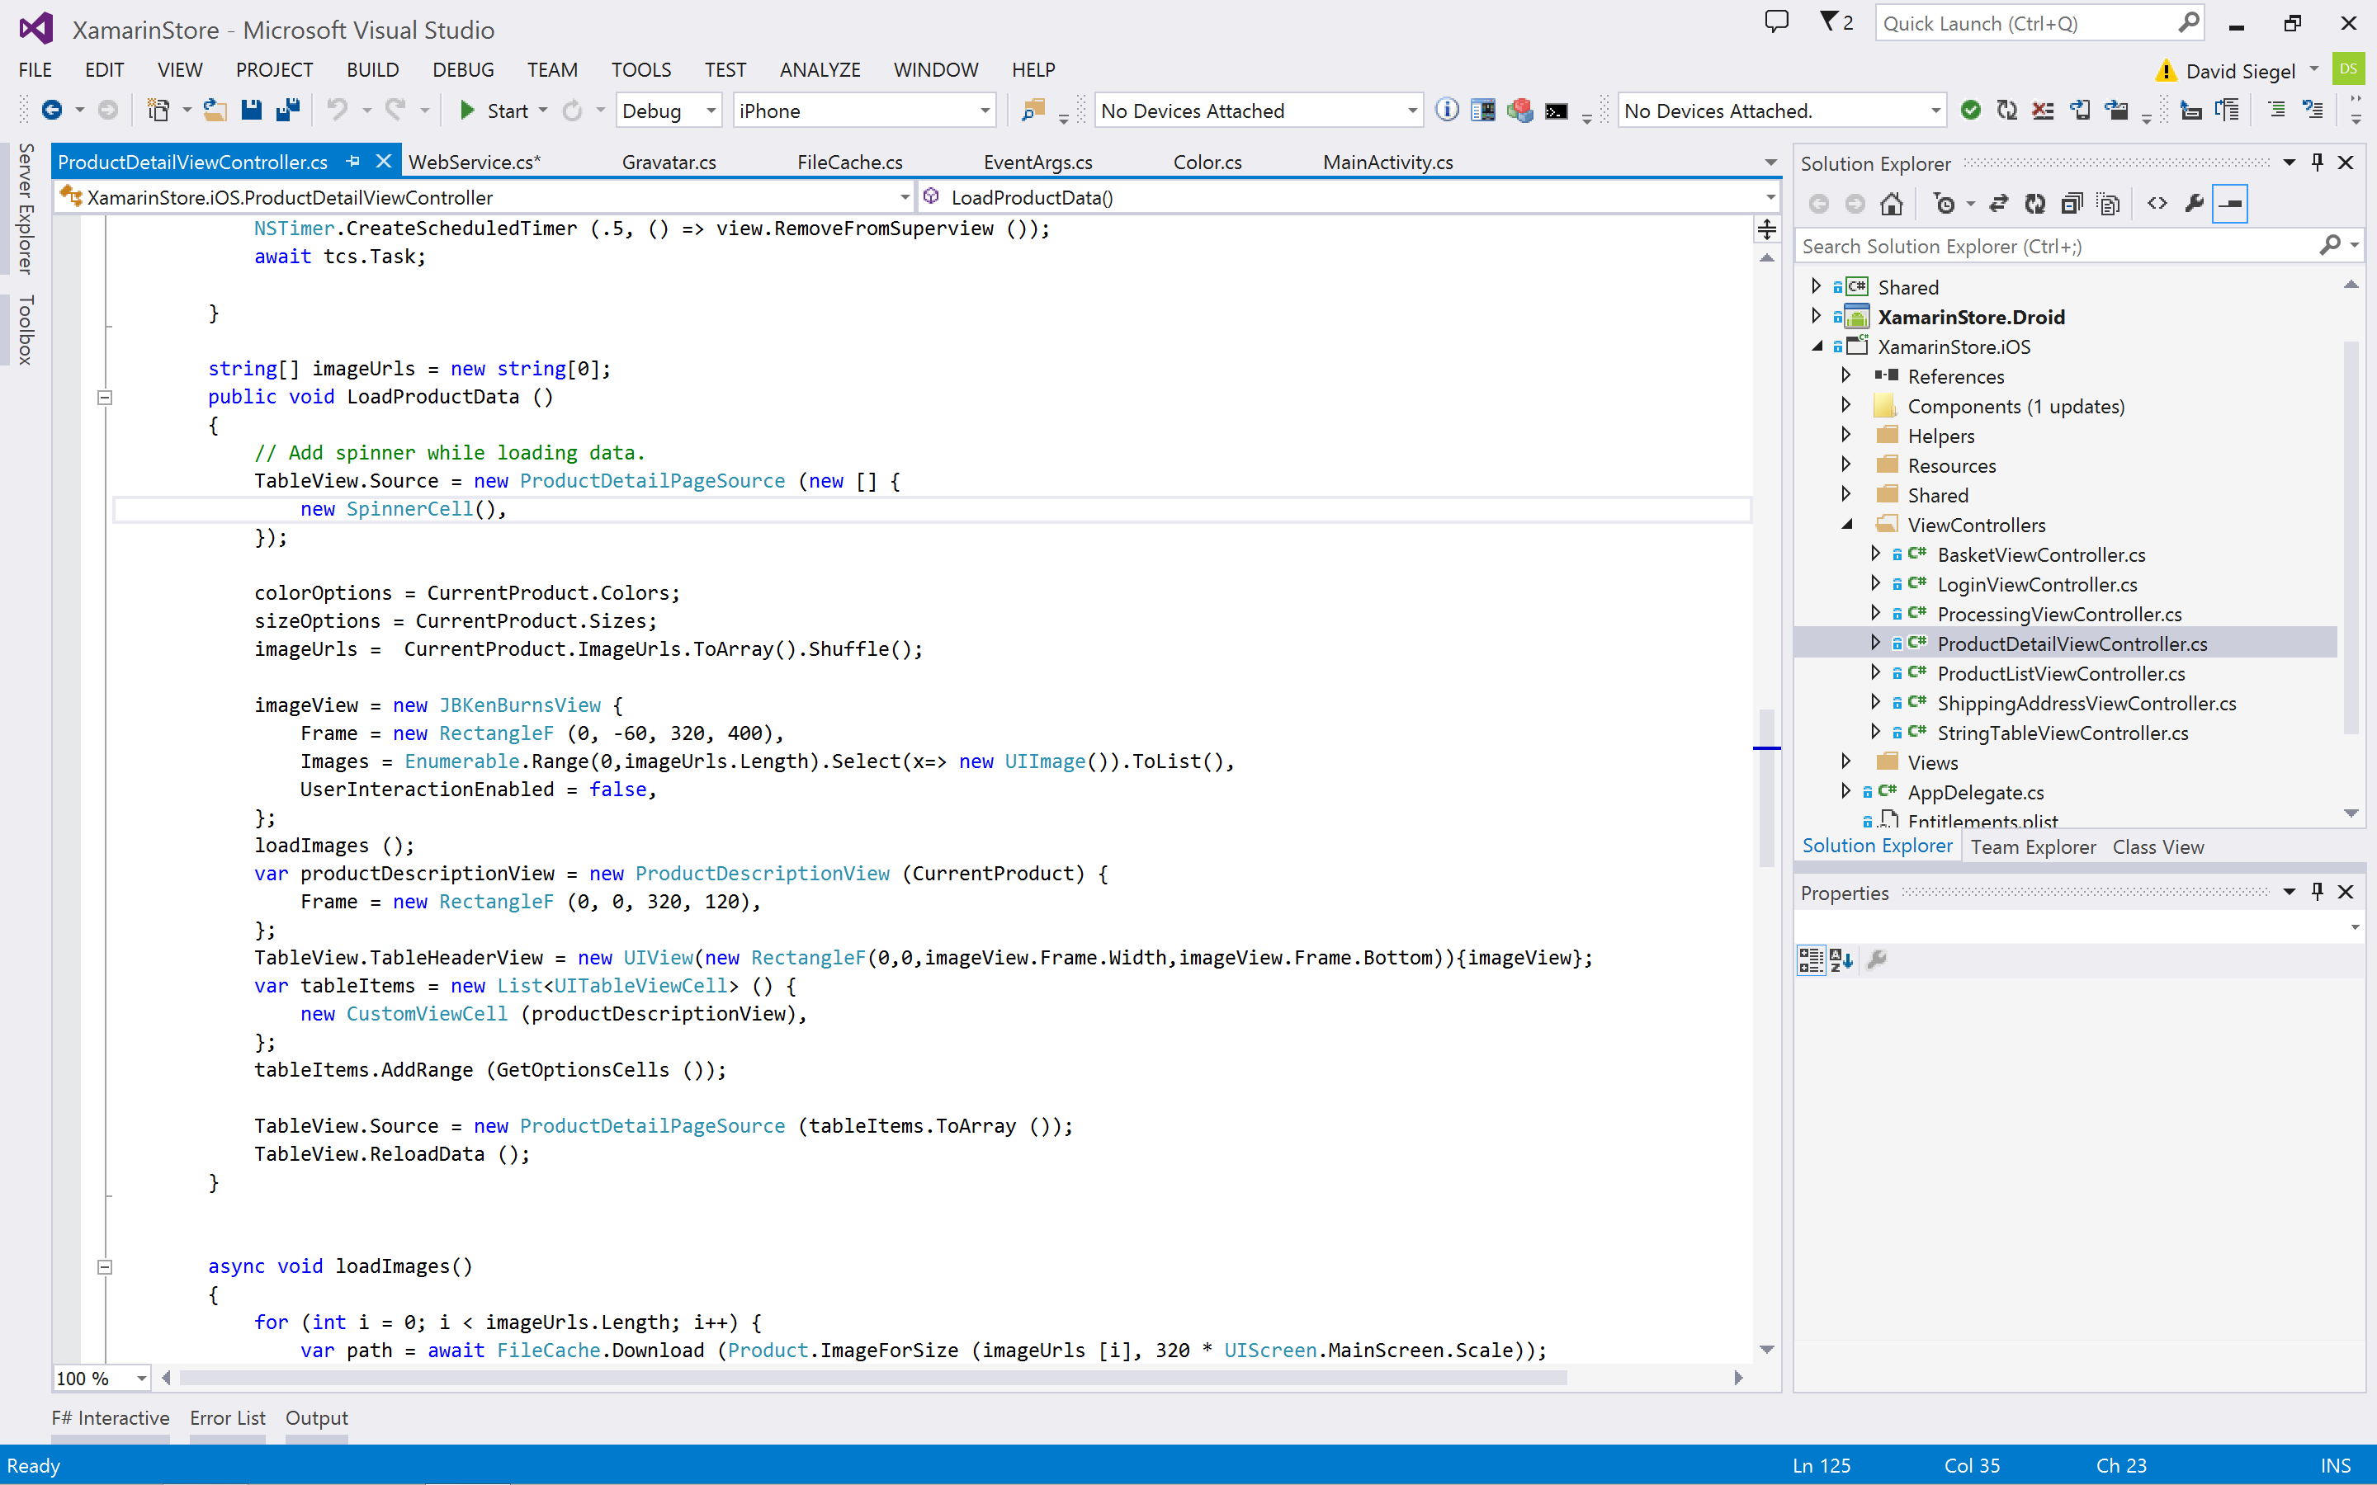
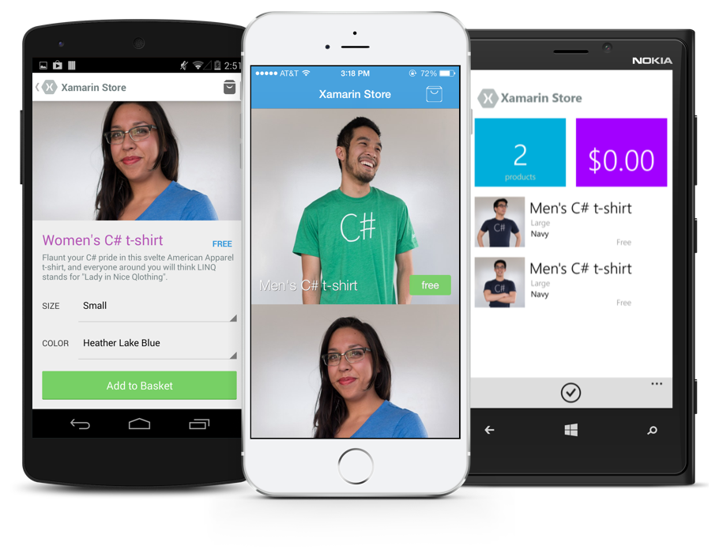
Anything you can do in Objective-C, Swift, or Java can be done in C# with Xamarin and Visual Studio.
Notes:
Say exactly. Pause for effect.

Slide 13

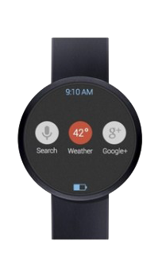
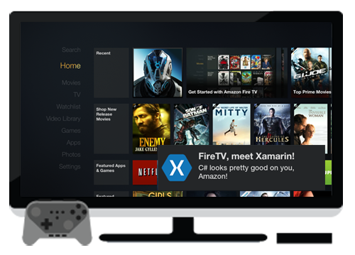
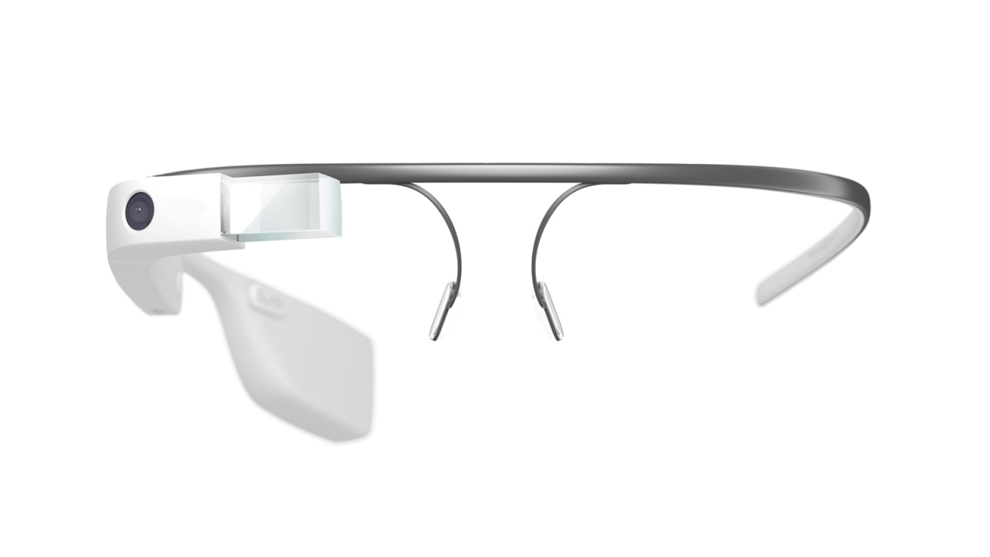
Always Up-to-Date
Track record of offering same-day support:
iOS 5, iOS 6, iOS 7, iOS 7.1, iOS 8
Full support for:
Google Glass
Android Wear
Apple Watch
Amazon Fire TV
More!
Notes:
Same-day support for all of the latest iOS releases
Big! You don’t want to have to wait for access.
Android doesn’t offer API previews, whereas iOS does.
Android bits usually in stable 4-8 weeks, but alphas / betas earlier
Not a huge deal on Android. Android 4.4 1% adoption after 4 months.
Mentioned iOS + Android + Windows
Fun doesn’t stop on phones / desktop! Build for Google Glass, Android Wear, Apple Watch, etc.

Slide 14
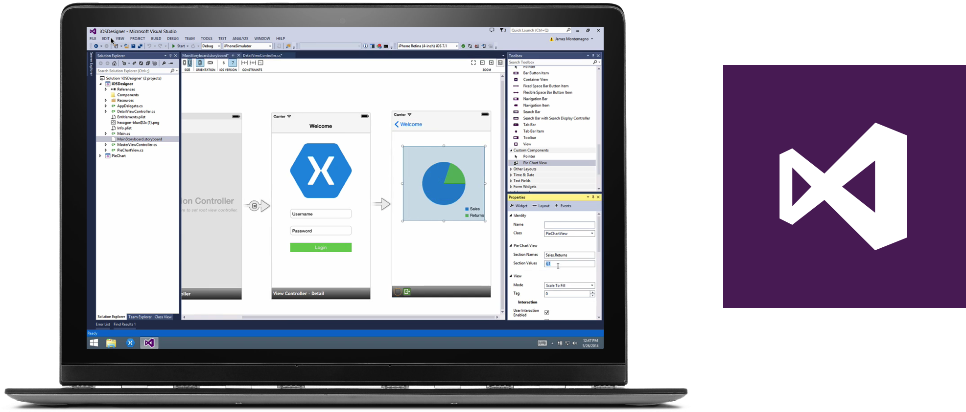
Visual Studio – 2010+
Notes:
Use the IDE you know and love to build amazing mobile apps for iOS and Android… as well as Windows Phone and Windows.
One stop-shop for development.
Imagine many of you have also downloaded VS 2015 RC… Xamarin included!
Click option when installing to auto-install Xamarin as well

Slide 15
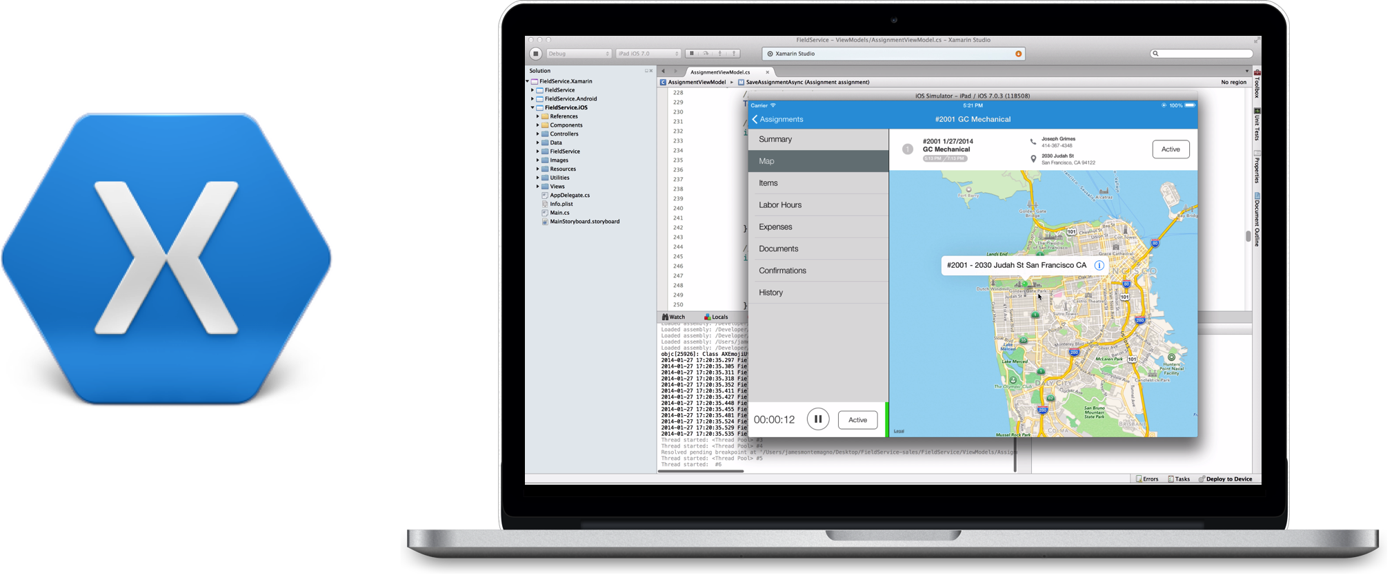
Xamarin Studio – Mac or PC
Notes:
Xamarin Studio is a great alternative IDE
Available for Windows + Mac

Slide 16
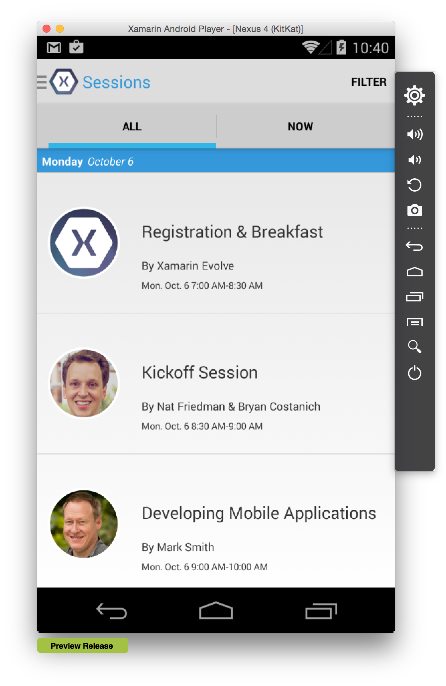
Xamarin Android Player
Rapidly demo and test app builds on Mac or PC
Hardware-accelerated virtualization
Runs side-by-side Windows Phone Emulator
Free for Xamarin Subscribers
xamarin.com/Android-Player
Notes:
Stock Android emulators are a big pain point
Use the Xamarin Android Player to fix this!
Rapidly demo and test app builds using a Mac or PC
Hardware-accelerated virtualization. Very fast!
What about running alongside Windows Phone Emulator?
WORKS!

Slide 17
Xamarin Native HOL
Hello, Android Quickstart
http://1drv.ms/1oLrBpN

Slide 18
Code Sharing
Notes:
Mentioned code-sharing earlier, now want to dive into that.

Slide 19
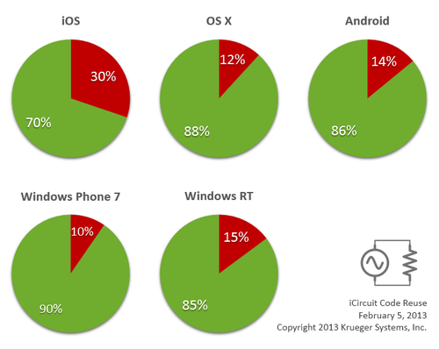

Code Sharing: Accelerate Development
Up to 90% Code Reuse
Leverage existing libraries
Code-sharing stats from iCircuit, built with Xamarin and featured on the App Store.
Source: http://praeclarum.org/post/42378027611/icircuit-code-reuse-part-cinq
Notes:
iCircuit is made by Frank Krueger, a long time Mono & Xamarin developer.
Real-time circuit simulator and editor used to design analog and digital circuits
Featured in App Store and physical Apple Stores
Sharing code lead to 70 to 90% code reuse across platforms speeding up development

Slide 20
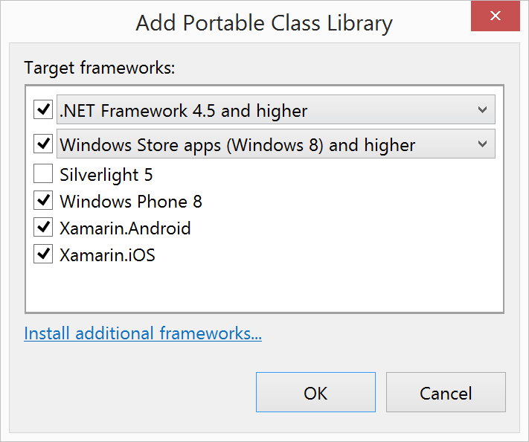
Portable Class Libraries
1 Assembly
Multiple Platforms
Including
Xamarin.Android
Xamarin.iOS
Notes:
Portable Class Libraries are awesome!
You can write all of your C# code in one assembly and share across all platforms
Before the Xamarin & Microsoft Partnership PCLs were limited ONLY to Windows Platforms
Now add official support to create and use PCLs in Visual Studio and Xamarin Sudio

Slide 21
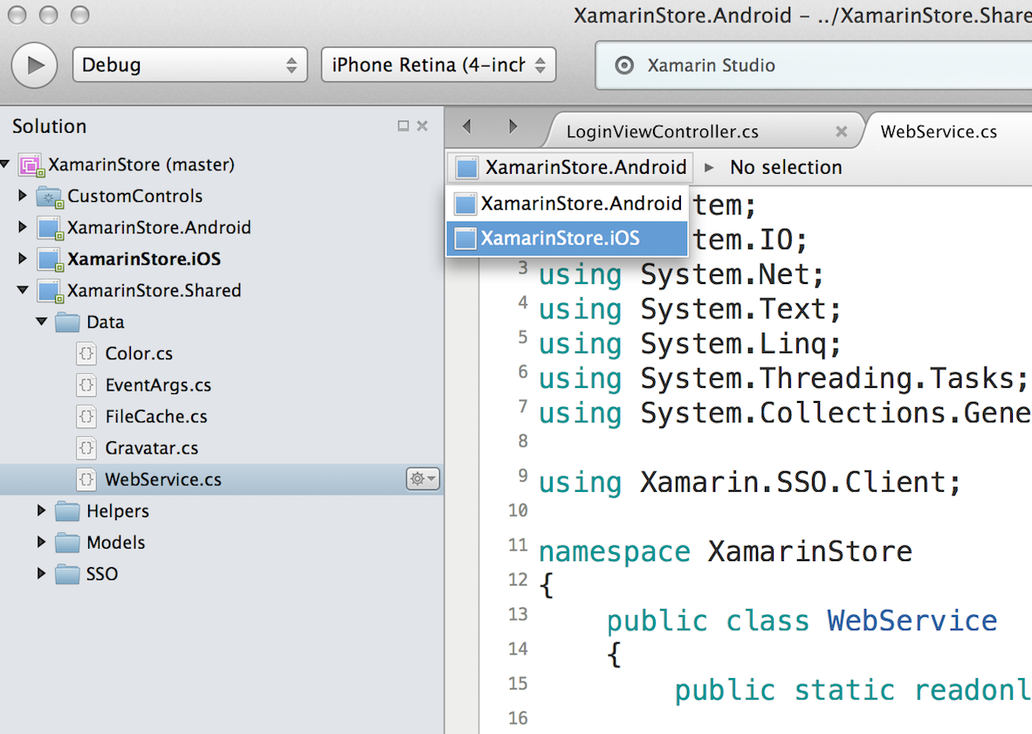
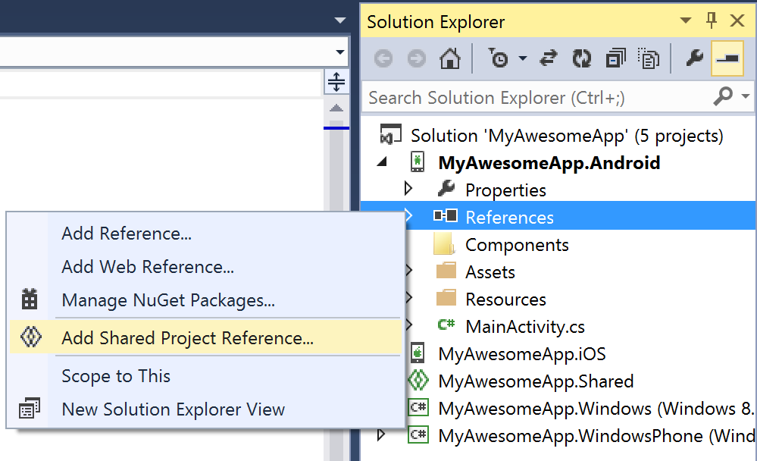
Shared Projects
Notes:
If you aren’t a PCL type of guy or girl, there is always shared projects as well!

Slide 22
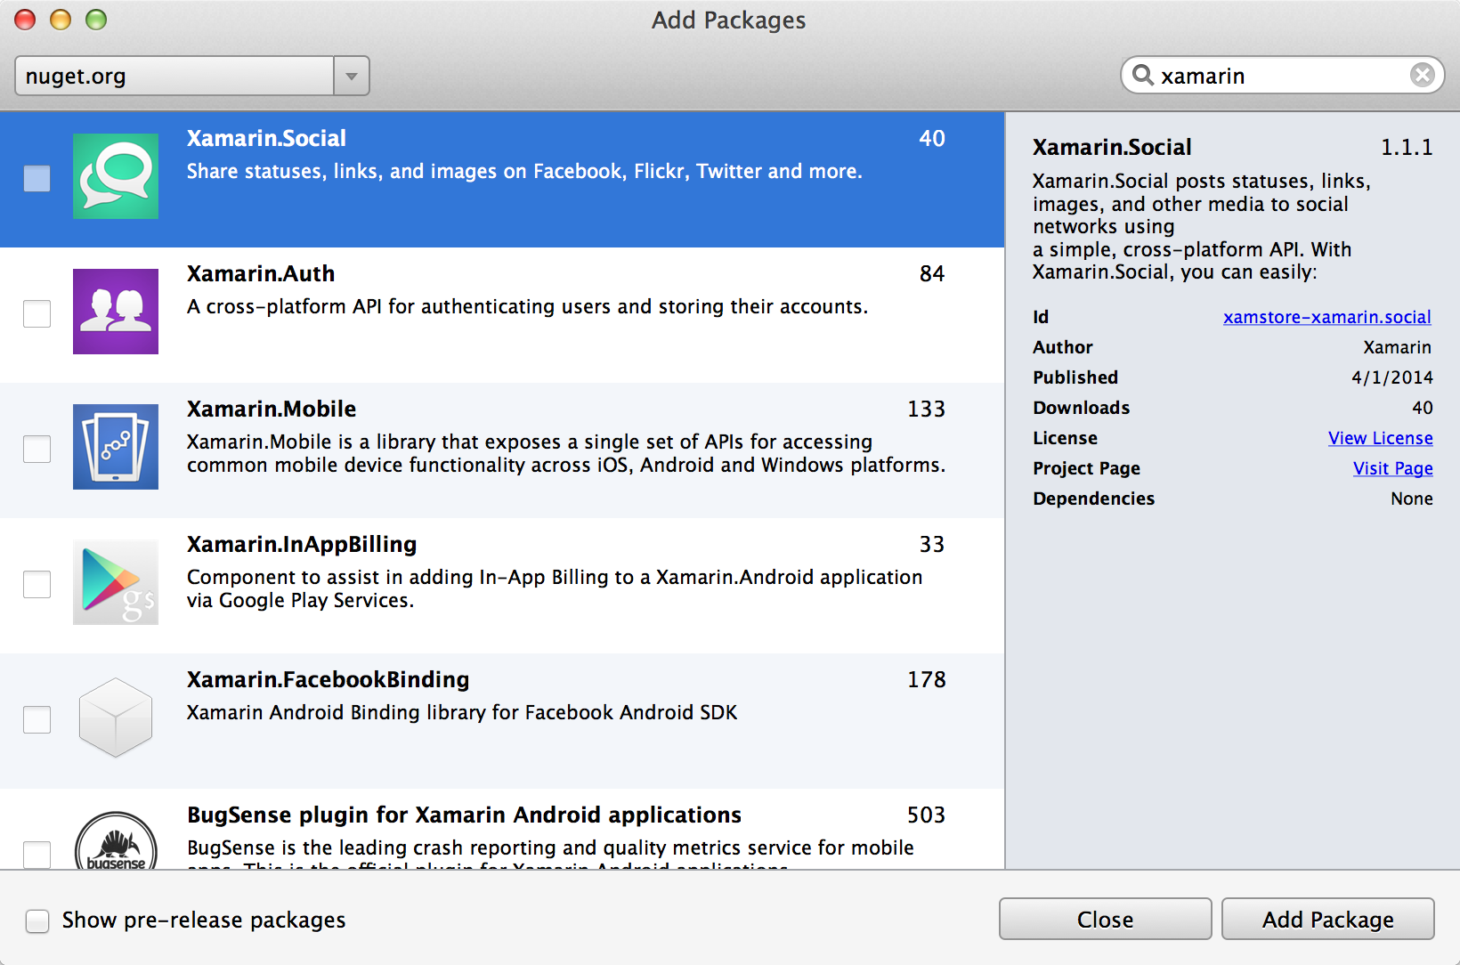
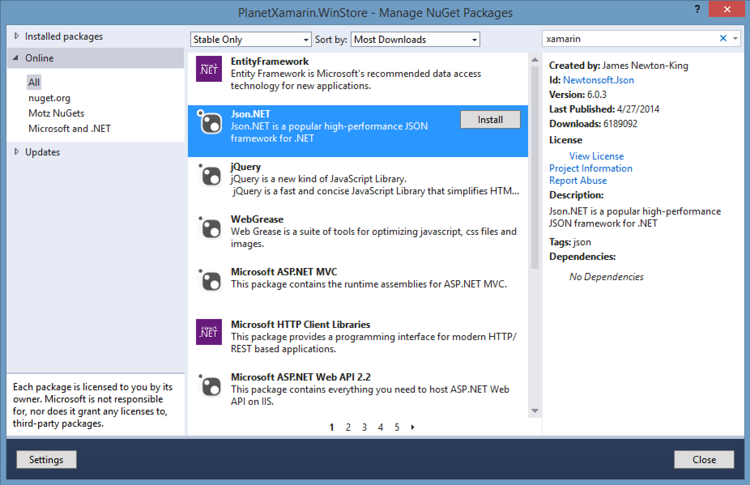
NuGet
Notes:
All the great libraries and frameworks that make development with C# such a pleasure
JSON.NET
Linq-2-Twitter
Plus some new Xamarin ones like Xamarin.Mobile

Slide 23
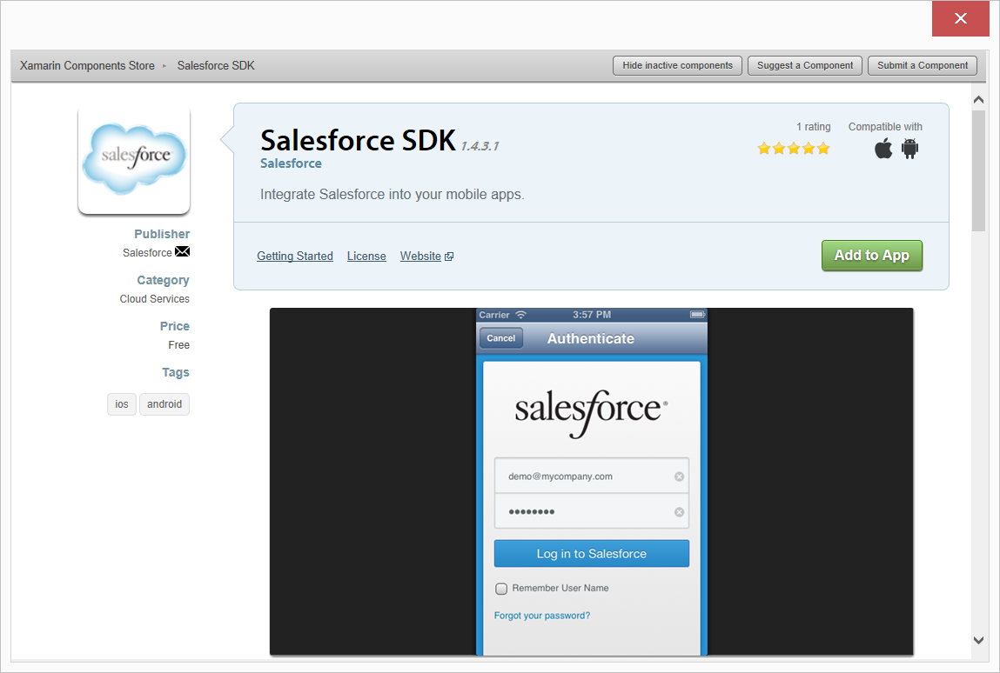
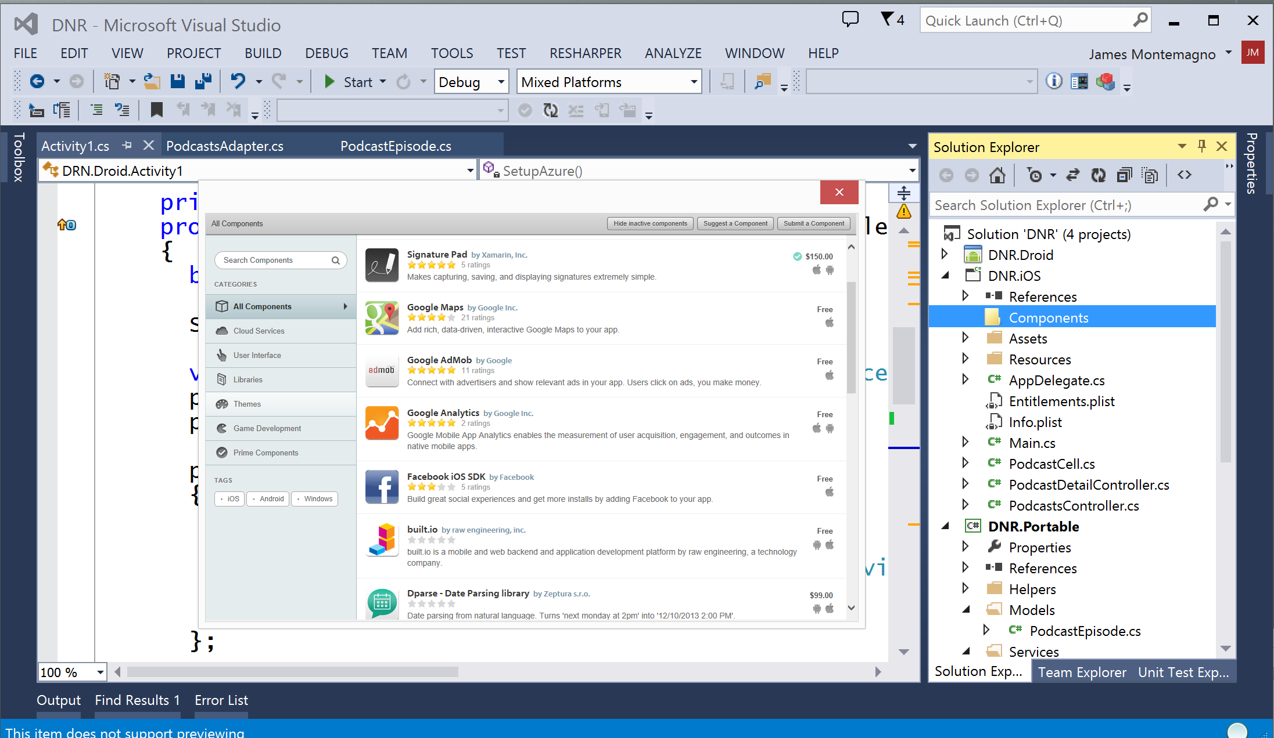
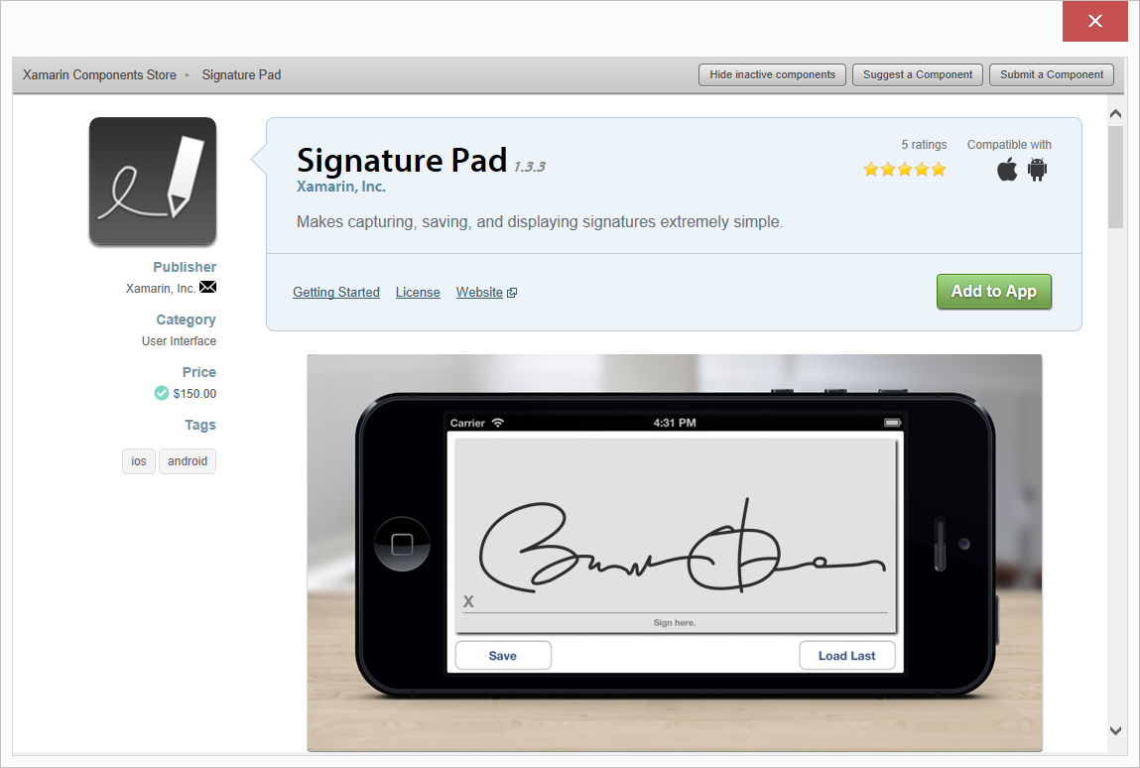
Xamarin Component Store
Build Apps Faster
Add high quality pre-built app components directly from Visual Studio and Xamarin Studio
Beautiful cross-platform UI controls, cloud services and enterprise backend integrations are just a few clicks away
Notes:
Add high quality pre-built app components directly from Visual Studio.
Lots of UI controls + SDKs available with just a click
Rapidly speed up dev time
Complements .NET NuGet ecosystem

Slide 24
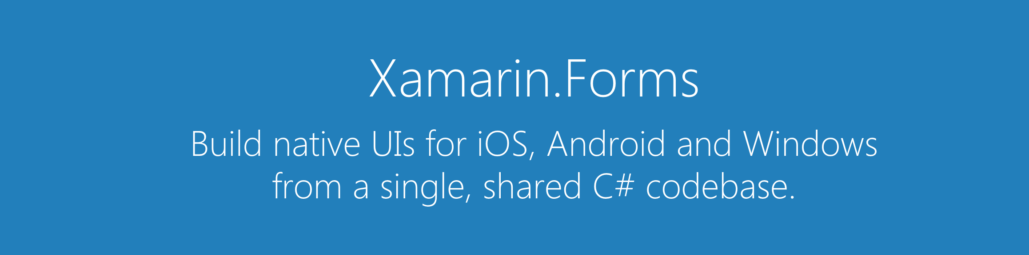
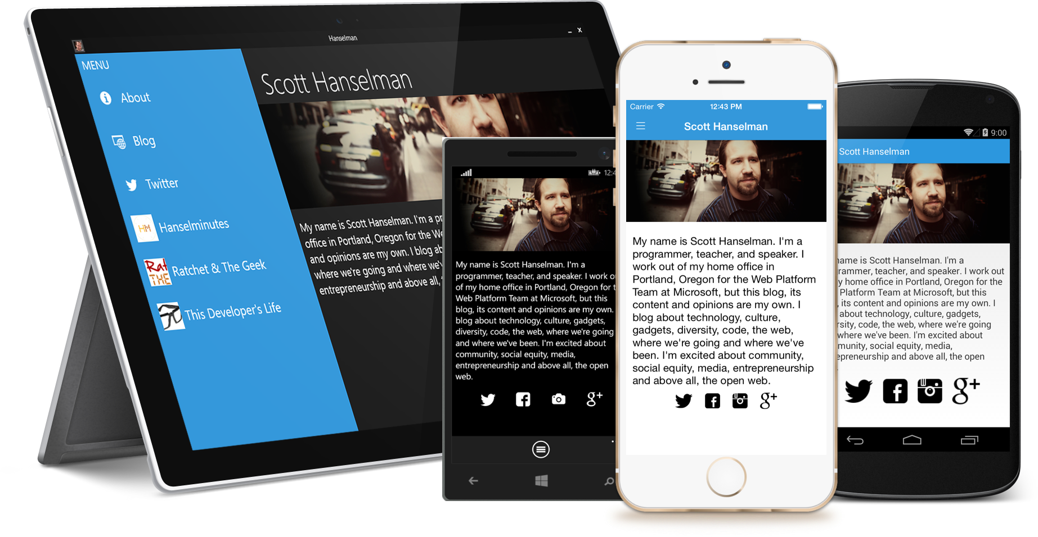
Notes:
If you want to share even more code…
Xamarin.Forms allows you to build native Uis for iOS, Android, and Windows from a single, shared C# codebase. Pause.

Slide 25
Xamarin + Xamarin.Forms
With Xamarin.Forms:
more code-sharing, native controls
Traditional Xamarin approach
Shared UI Code
Notes:
Remember traditional Xamarin approach from earlier
Build up UIs on a per-platform basis
Share the rest
How does this compare to Xamarin.Forms?
Take code sharing benefits from traditional approach and add a shared UI layer
Rendered completely natively.
Still can access platform-specific things!

Slide 26
What’s Included
40+ Pages, layouts, and controls
(Build from code behind or XAML)
Two-way data binding
Navigation
Animation API
Dependency Service
Messaging Center
Shared UI Code
Notes:
Much more than a framework.
Includes everything you need to get up and running to build fully native applications.
Build native UIs in either C# or… XAML!
If you are used to MVVM, this feels right at home!

Slide 27
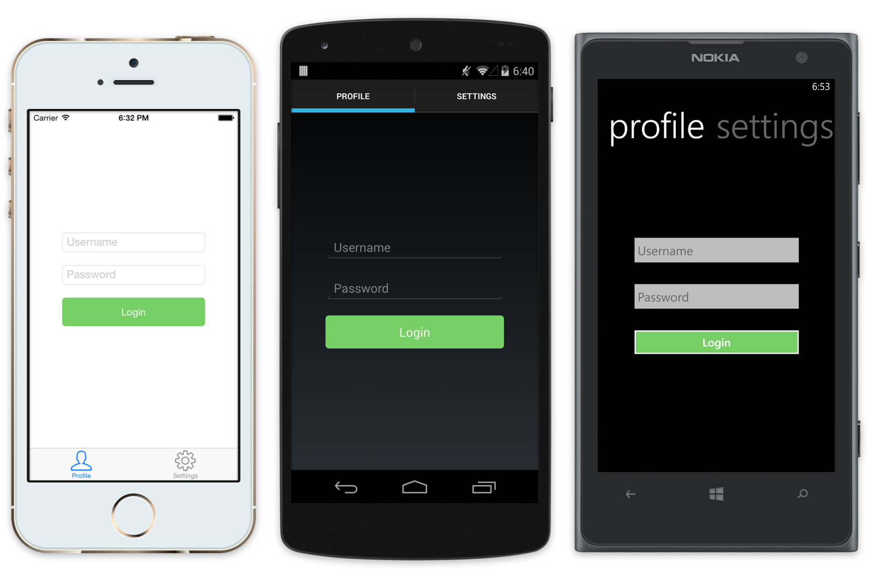
Native UI from shared code
<?xml version="1.0" encoding="UTF-8"?>
<TabbedPage xmlns="http://xamarin.com/schemas/2014/forms"
xmlns:x="http://schemas.microsoft.com/winfx/2009/xaml"
x:Class="MyApp.MainPage">
<TabbedPage.Children>
<ContentPage Title="Profile" Icon="Profile.png">
<StackLayout Spacing="20" Padding="20"
VerticalOptions="Center">
<Entry Placeholder="Username"
Text="{Binding Username}"/>
<Entry Placeholder="Password"
Text="{Binding Password}"
IsPassword="true"/>
<Button Text="Login" TextColor="White"
BackgroundColor="#77D065"
Command="{Binding LoginCommand}"/>
</StackLayout>
</ContentPage>
<ContentPage Title="Settings" Icon="Settings.png">
<!-- Settings -->
</ContentPage>
</TabbedPage.Children>
Notes:
Build a simple login screen using XAML on right-hand side
Rendered natively…
Very similar to XAML seen when doing Windows development

Slide 28
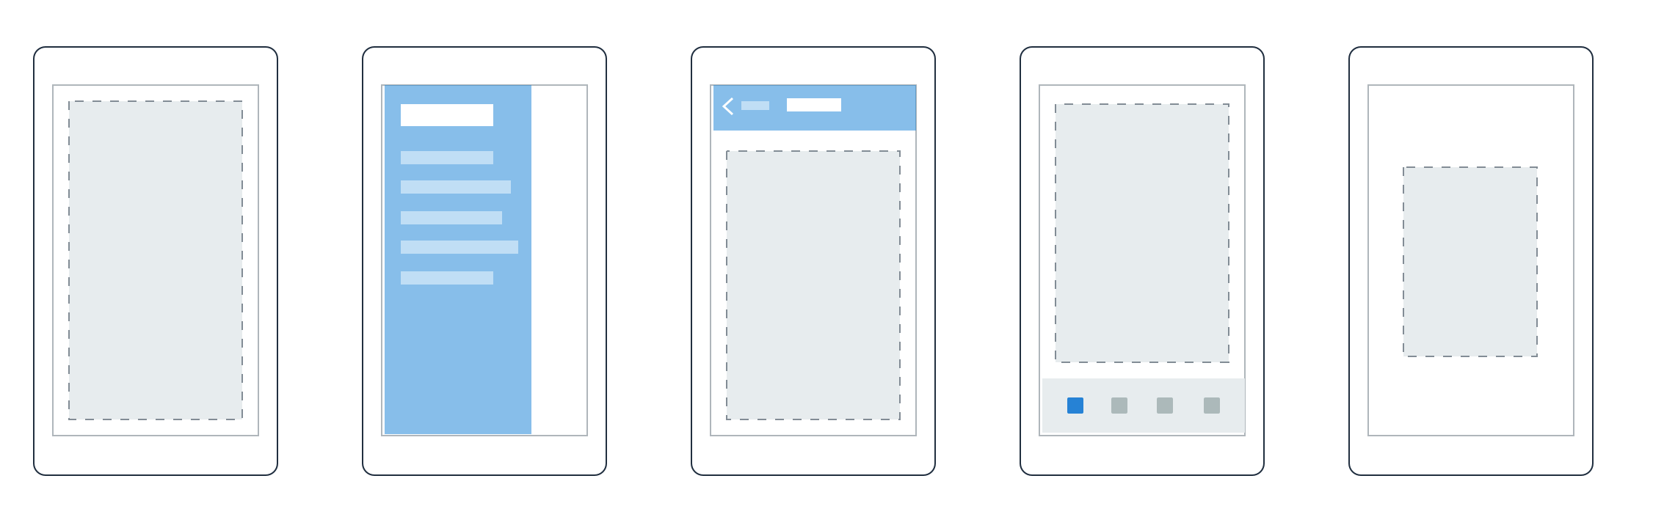

Pages
Content
MasterDetail
Navigation
Tabbed
Carousel
Notes:
Pages represent a screen in your application.
Several different pages given by default…
Remember… each is rendered natively
Tabbed View = ?
iOS tabs on bottom
Android on top
Windows Phone you have pivot control

Slide 29
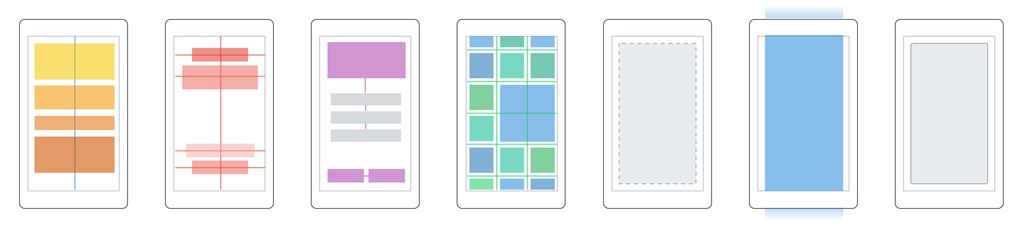
Layouts
Stack
Absolute
Relative
Grid
ContentView
ScrollView
Frame
Notes:
Inside a page there are layouts
Describe how UI elements are to be arranged within a page
You can use simple things like StackLayout (like StackPanel) or even things like Grids

Slide 30
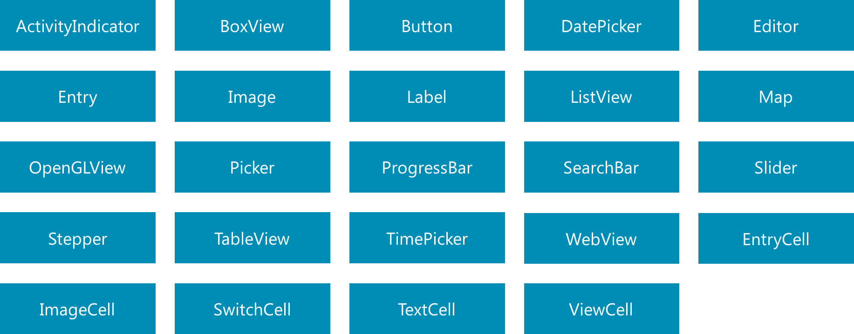
Controls
Notes:
More than 40 controls, layouts, and pages to mix and match from.
All included “in the box”. You can always create your own!
Remember… native…
Entry
iOS = UITextField
Android = EditText
Windows Phone = TextBox

Slide 31
Windows | Xamarin.Forms
StackPanel | StackLayout
TextBox | Entry
ListBox | ListView
CheckBox | Switch
ProgressBar | ActivityIndicator
Grid | Grid
Label | Label
Button | Button
Image | Image
Date/TimePicker | Date/TimePicker
Control Comparison
Notes:
You should feel right at home as a Windows Developer
Very similar naming conventions

Slide 32
Binding
Comparison
Windows | Xamarin.Forms
DataContext | BindingContext
{Binding Property} | {Binding Property}
ItemsSource | ItemsSource
ItemTemplate | ItemTemplate
DataTemplate | DataTemplate
Notes:
Not only are controls similar, but binding too.
If you are currently doing Windows development, you will find Xamarin.Forms right at home.

Slide 33
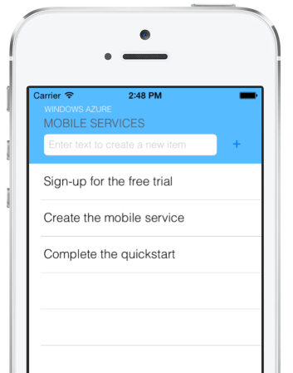
Microsoft Azure
Build amazing mobile apps in C# with Xamarin
Build amazing backends using Azure
Integrate Xamarin & Azure
Azure Mobile Services
Azure Messaging
Azure Storage
Notes:
Build amazing frontends using Xamarin… build amazing backends using Azure
Azure Mobile Services
Xamarin Component for iOS + Android
Azure Messaging
Push notifications for iOS + Android
Azure Storage
In preview as of Build 2015! Download via NuGet

Slide 34
Xamarin Native HOL
Daum Book API
http://1drv.ms/1oLrBpN

Slide 35
Daum 검색 API http://developers.daum.net/

Slide 36

Daum Open APIs

Slide 37
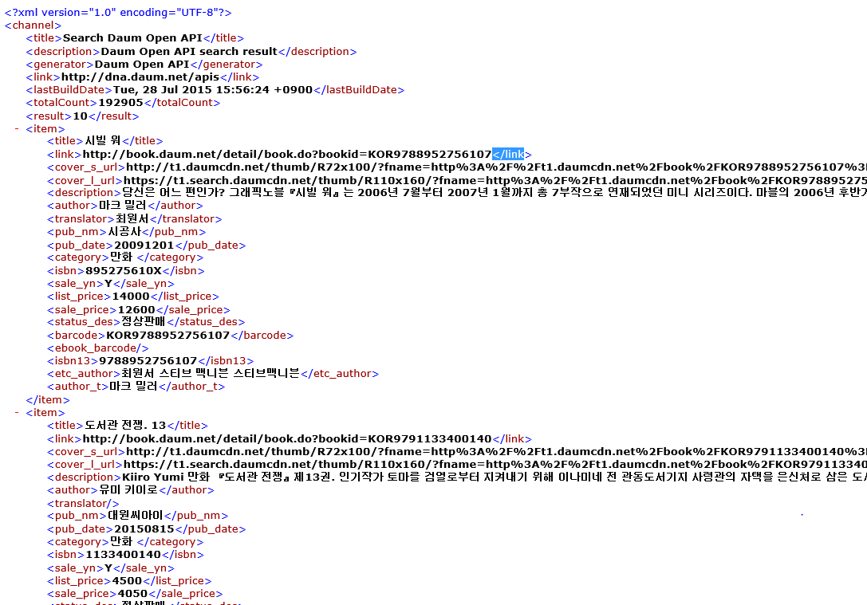
Daum Open APIs

Slide 38
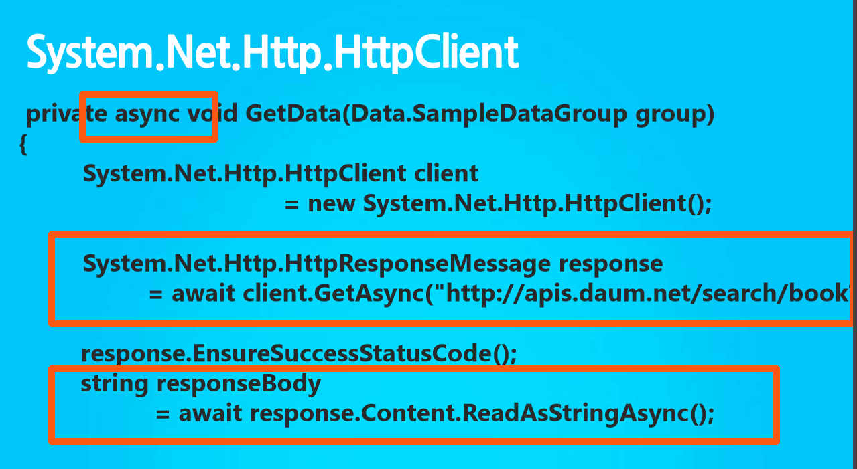
System.Net.Http.HttpClient
Namespace: System.Net.Http.HttpClient Assembly: System.Net.Http (in System.Net.Http.dll)

Slide 39
System.Net.Http.HttpClient

Slide 40
Entity Class
class BookItem
{ public Int64 Id { get; set; } public string Title { get; set; } public string Category { get; set; } public string ImageUrl { get; set; } public string Description { get; set; } }

Slide 41
Linq

Slide 42

Architecture
C#
VB.NET
Others
.NET Language Integrated Query (LINQ)
LINQ data source providers
ADO.NET support for LINQ
LINQ to Objects
LINQ to Datasets
LINQ to SQL
LINQ to Entities
LINQ to XML

Slide 43
LINQ to Objects
C# int[] nums = new int[] {0,4,2,6,3,8,3,1}; double average = nums.Take(6).Average(); var above = from n in nums where n > average select n;

Slide 44
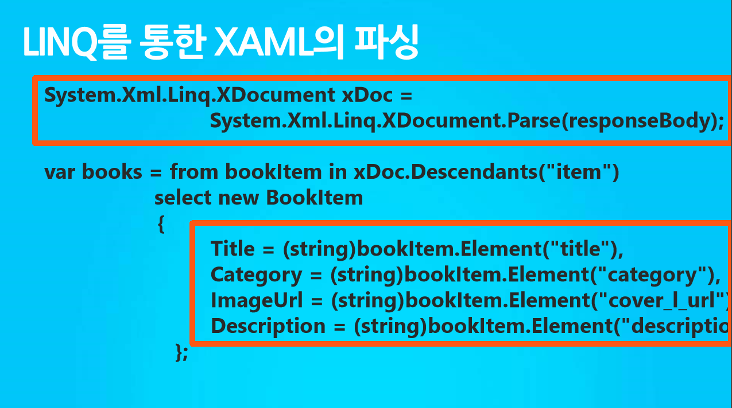
System.Net.Http.HttpClient

Slide 45
Linq

Slide 46
Data binding

Slide 47

Data binding basics

Slide 48
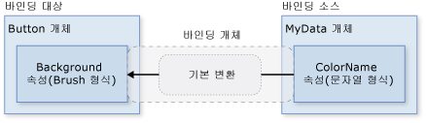
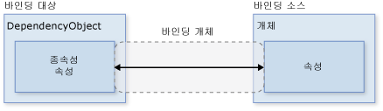
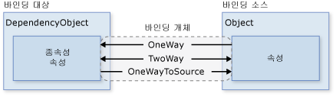
https://msdn.microsoft.com/ko-kr/library/ms752347(v=VS.110).aspx

Slide 49
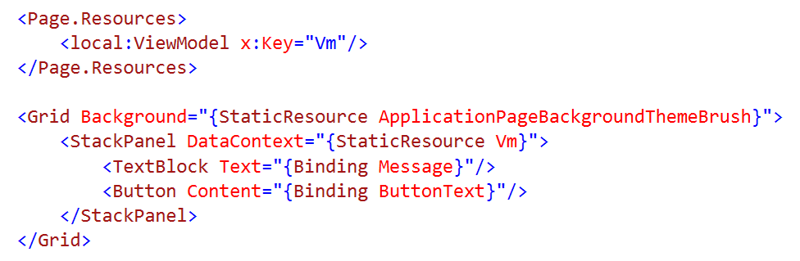
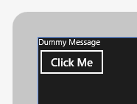
Dynamic Data
Use data binding to connect to a data source
Typical data source would be a view model

Slide 50
Data Binding

Slide 51





Integrate
Simple integrations into popular services for mission critical notifications.

